Slide 1

Geethanjali College of Engineering and Technology
APILogGuard for Security Events
Batch No:C7
Guide: A Rahul
Team Members:
A. Bhavya Sri (21R11A05A5)
K. Bharath Kumar (21R11A05C8)

Slide 2
Table of Contents
Domain
Problem Statement
Requirement Gathering
Software & technology Stack
System Architecture
Exception Output
Existing System Analysis

Slide 3
Domain
Web security
Api monitoring
By leveraging tools such as Prometheus, Grafana, and SIEM, we aim to provide real-time threat detection and automated alerts, addressing critical security vulnerabilities in API-driven applications.
01

Slide 4
Problem Statement
With the rapid increase in API-driven applications, securing APIs has become a major challenge. API security vulnerabilities, such as broken authentication, insufficient logging, and brute force attacks, expose sensitive data to attackers.
Need for the Project :
Many APIs lack proper logging and monitoring, making it difficult to detect security breaches.
Insufficient logging can result in delayed incident response and data breaches.
Existing monitoring solutions often focus on application health but lack detailed security event tracking.
02

Slide 5
Requirement Gathering
Functional Requirements
User Authentication (JWT-based login, role-based access)
API Request & Response Logging
Real-time Monitoring & Alerting (Prometheus & Grafana)
Suspicious Activity Detection
Log Storage & Analysis
03

Slide 6
Requirement Gathering
Non-Functional Requirements
Scalability – Handle large API traffic efficiently
Security – Encrypt logs, prevent unauthorized access
Performance – Ensure logging does not slow down APIs
03

Slide 7
Requirement Gathering
User Requirements
Developers – Need a secure API monitoring solution
Security Teams – Require real-time alerts for API threats
System Admins – Need visibility into API usage trends
03

Slide 8
Requirement Gathering
Feasibility Analysis
Technical Feasibility – Uses widely supported tools (Node.js, MongoDB, Prometheus)
Economic Feasibility – Uses open-source monitoring tools (low-cost implementation)
Operational Feasibility – Easy to integrate with existing APIs
03

Slide 9
Software & Technology Stack
Component | Technology | Applications
Backend | Node.js (Express.js) | Scalable, lightweight, widely used for APIs
Database | MongoDB | NoSQL, ideal for storing logs
Authentication | JWT (JSON Web Tokens) | Secure token-based authentication
Monitoring | Prometheus & Grafana | Real-time API monitoring & visualization
Alerting | Webhook-based alerts | Automated notifications
Security | SIEM Compliance, Rate Limiting | Aligns with industry standards
04

Slide 10
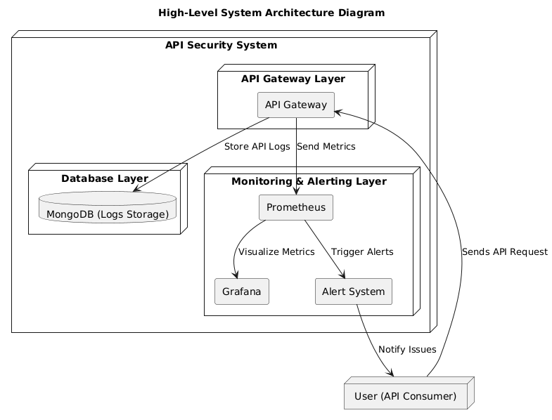
System Architecture
Layered Architecture
05

Slide 11
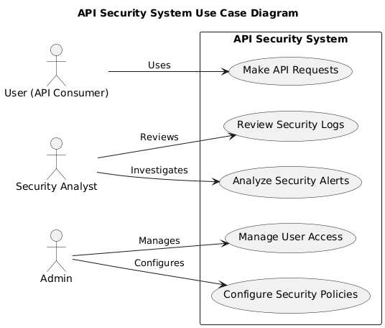
System Architecture
UseCase Diagram
05

Slide 12
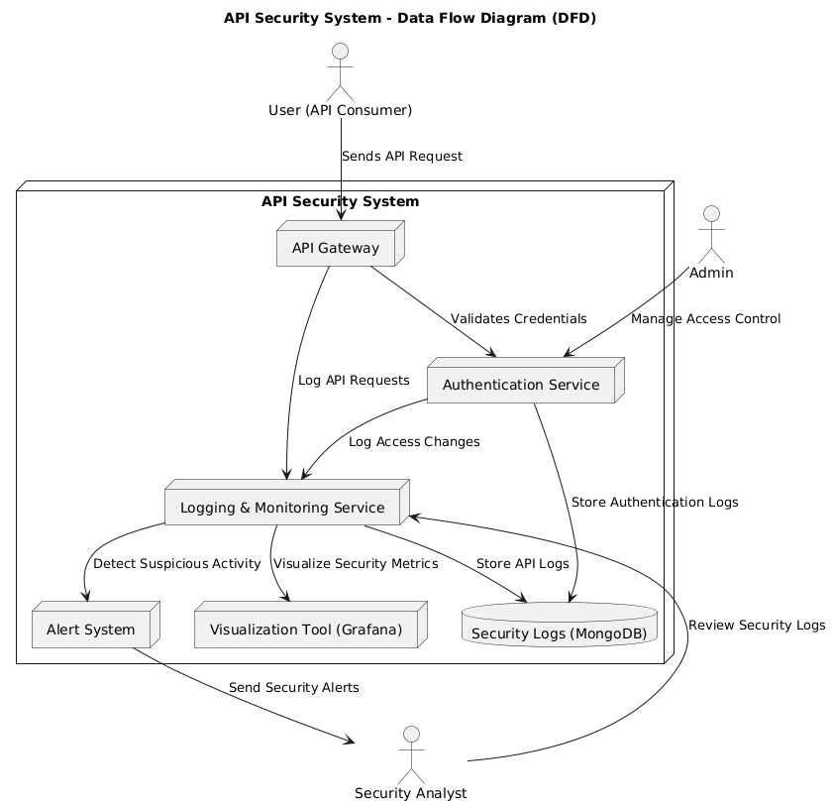
System Architecture
DataFlow Diagram
05

Slide 13
Expected Outcomes
Final Product:
A security monitoring system that provides real-time logging, analysis, and alerts for API security.
Expected Features:
Secure API logging with request & response tracking
Visualization dashboards (Grafana)
Automated alerts for anomalies
SIEM-compatible logs for compliance
06

Slide 14
Existing System Analysis
Existing Systems & Limitations
Cloud Logging Tools (AWS CloudWatch, Azure Monitor) – Expensive, not fully security-focused
SIEM Solutions (Splunk, ELK Stack) – Require complex configurations
Traditional API Gateways (Kong, Apigee) – Focus on API management, lack detailed logging
How Our System Improves on Existing Solutions
Open-source & cost-effective compared to enterprise SIEM solutions
Lightweight & easy to integrate with any API-based system
Focus on security logging, not just API performance monitoring
07

Slide 15
Thank You!

